Slide 1
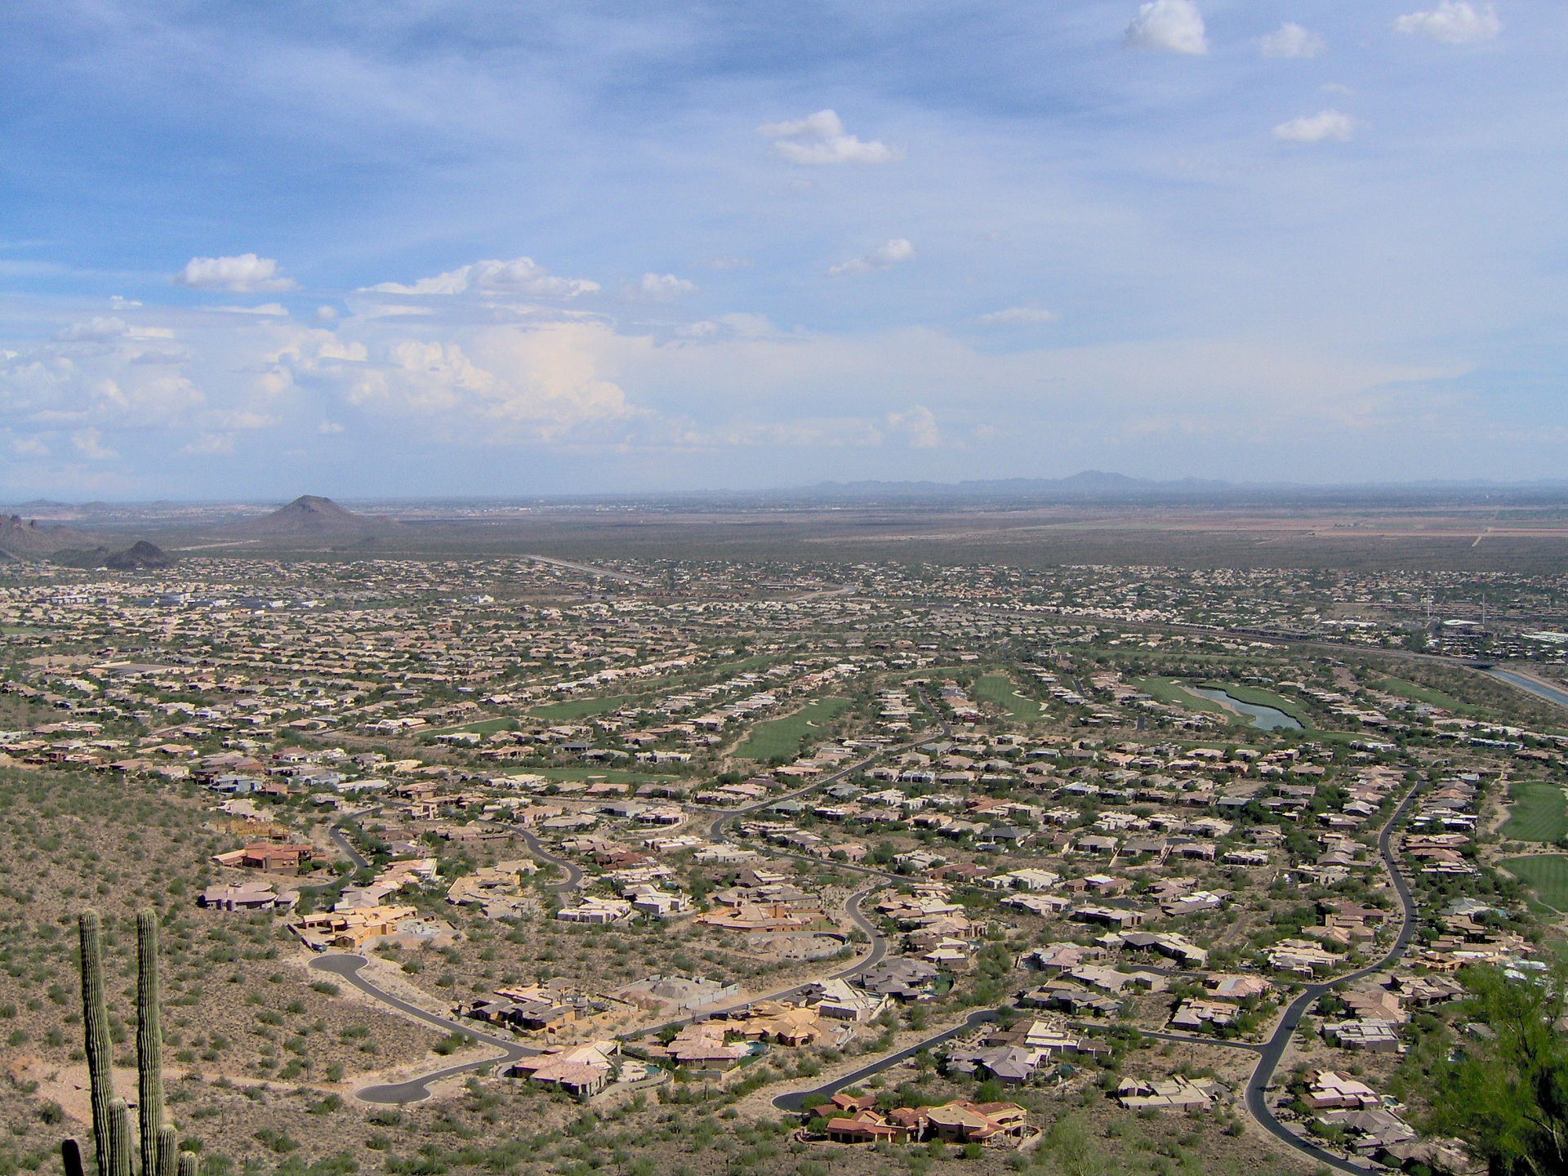
Settler activity
TASK- State three problems that urban sprawl could be causing in the location below.
Location: Phoenix, Arizona, United States.

Slide 2
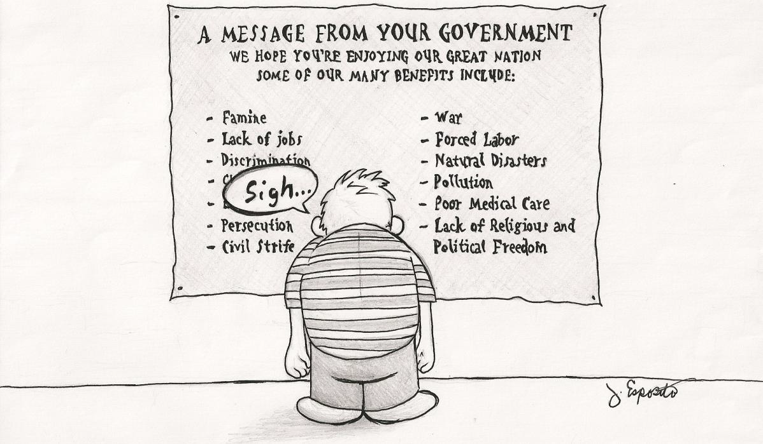
Starter activity
TASK- Describe the emotional state of the character in the cartoon. Why do you think he feels this way?
EXTENSION- In which country do you believe this character lives? Why?

Slide 3
Date push and pull factors
Learning Objectives:
I can explain the various reasons that encourage people rural-urban migration.
I can investigate urbanisation in China and apply my knowledge to create my own immigration story.

Slide 4
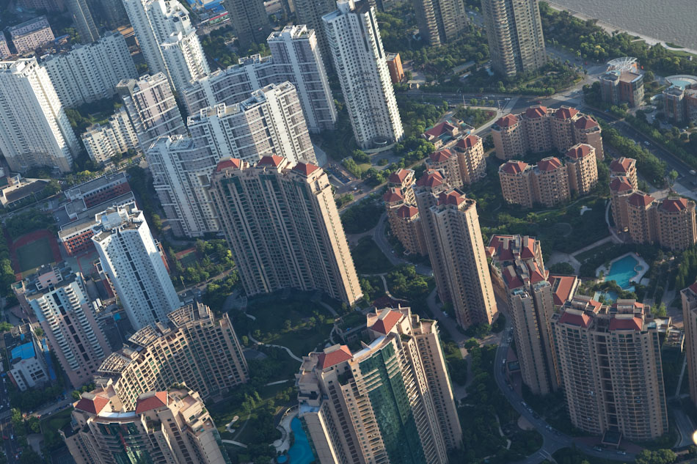
TASK- Add the following key terms to your glossary.
Migration- the process whereby people move to live in another place, this may be forced or voluntary.
Push factors- these are reasons why people migrate from a place e.g. the water supply is unreliable.
Pull factors- these are reasons why people migrate to a place e.g. there are lots of jobs available.
z

Slide 5

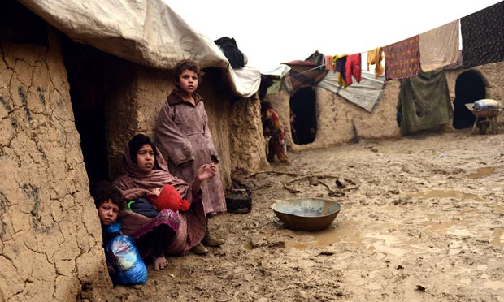

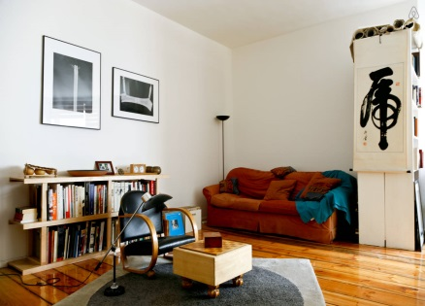



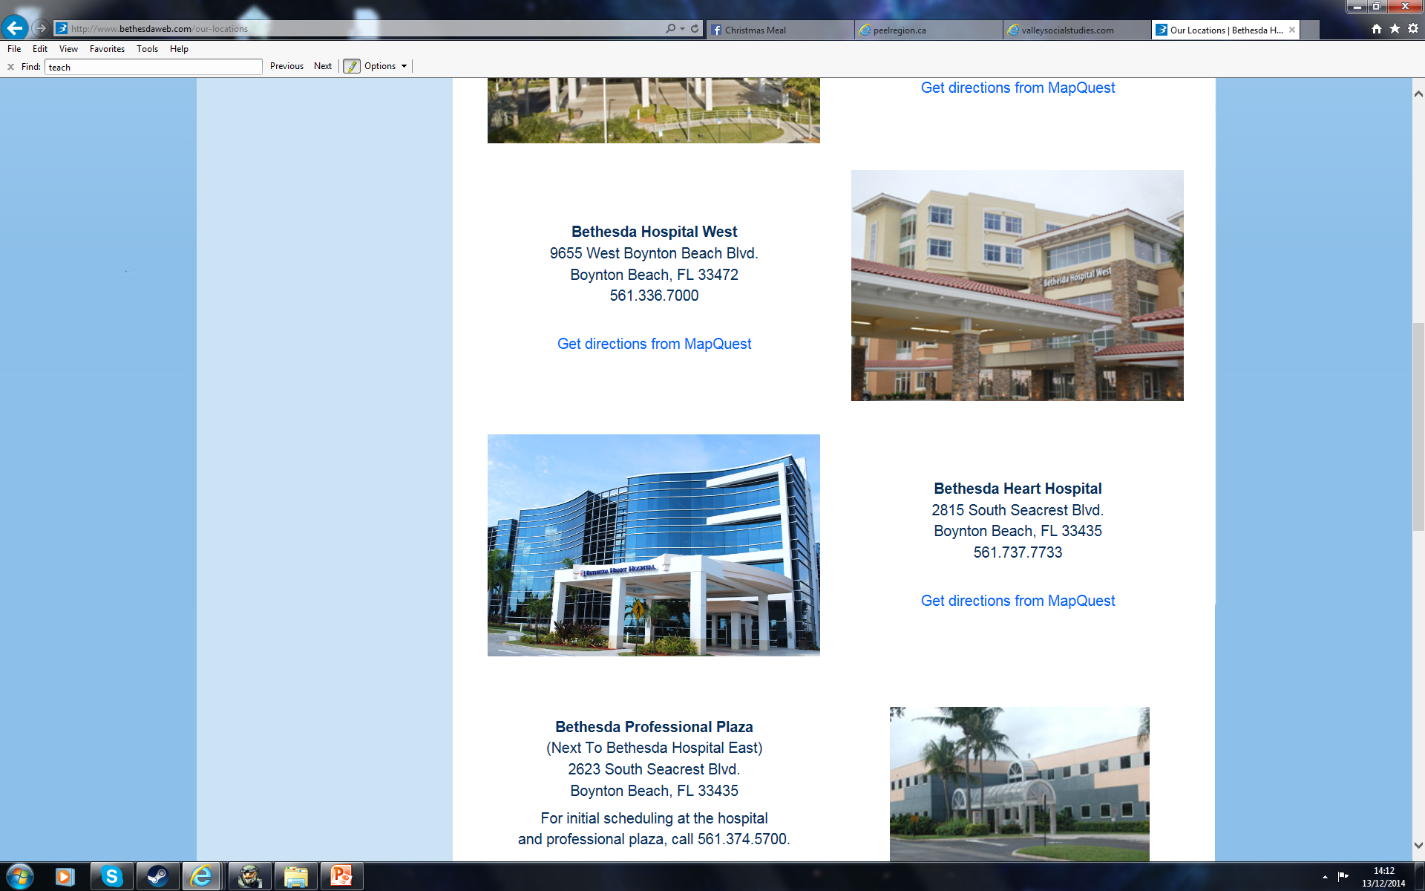
TASK- To work in pairs to identify reasons which cause people to migrate to urban areas.
INSTRUCTIONS:
Assign yourselves either the letter ‘A’ or letter ‘B’.
Student A: Create a list of possible push factors.
Student B: Create a list of possible pull factors.
5 Minutes
Push factors | Pull factors
2. Student A should explain and teach Student B the push factors they have come up with. Once complete, swap over and repeat.
3. Add any ideas your partner didn’t come up with to your table.
5 Minutes

Slide 6
TASK- Add any push and pull factors you didn’t get into your table in blue pen.
Push factors | Pull factors
- lack of religious freedom - corrupt governments - lack of opportunity - poor education - lack of religious freedom - civil strife - lack of medical care - natural disasters - poverty | - religious freedom or freedom in general - higher standard of living - jobs - lower cost of living - medical care / medicine - safety/protection - fair or just government

Slide 7
TASK- To test your knowledge of push and pull factors through a physical activity game!
INSTRUCTIONS:
Statements will be read out that will be a push factor, pull factor, or both.
If you think it is a:
Push factor: squat 5 times
Pull factor: hop back and forth 5 times.
Both: jump and then touch your toes 5 times.
3. You must march on the spot between statements.
Make sure the floor is clear of obstacles!

Slide 8
Family
Climate
Security
Job opportunities
Natural disaster
Discrimination
Higher standard of living
If you think it is a:
Push factor: squat 5 times
Pull factor: hop back and forth 5 times.
Both: jump and then touch your toes 5 times.

Slide 9
push and pull factors
Learning Objectives:
I can explain the various reasons that encourage people rural-urban migration.
I can investigate urbanisation in China and apply my knowledge to create my own immigration story.

Slide 10
TASK- To understand why people migrate to cities in LEDCs.
10 Minutes
Urbanisation in China
BRONZE- Write a definition for the term ‘rural-urban migration’.
SILVER- Using the information on page 37, complete the mindmap above. Include facts and figures.
GOLD- Why might estimates of future urban populations in developing countries be inaccurate?

Slide 11
TASK- Create your own immigrant story based upon our learning today.
10 Minutes
INSTRUCTIONS:
Your story should:
Describe what life was like in their homeland.
Explain they decided to leave (push factors).
Explain why they chose ______*(*Country) (pull factors).
A long time ago I used to live in…
Life was difficult since…
I decided to leave my homeland because…
I wanted to move to _______ because…
Possible scenarios:
A Polish immigrant who cannot get work.
A Nigerian farmer whose crops have failed.
A Syrian family fleeing the terrorist group Islamic State.
EXTENSION- Justify why they chose to move to your chosen country rather than other countries.

Slide 12
push and pull factors
Learning Objectives:
I can explain the various reasons that encourage people rural-urban migration.
I can investigate urbanisation in China and apply my knowledge to create my own immigration story.

Slide 13
homework
Explain why people move from rural to urban areas in LEDCs. [4]

